Slide 1
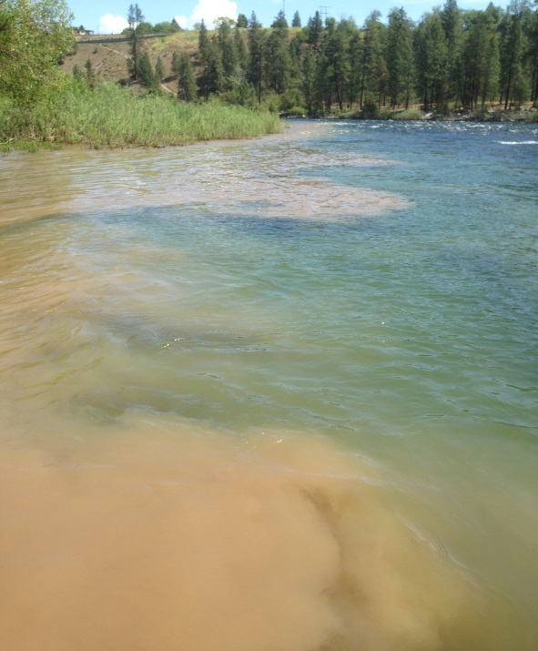
Water Quality Report Card
Hangman Creek Overall Grade:
F
During our first year of water quality monitoring, we monitored water quality primarily in Hangman Creek, but sampled the Spokane and Little Spokane Rivers as well. We found Hangman Creek to be heavily polluted with nutrients, sediment, and high temperatures, while the Spokane and Little Spokane Rivers were much cleaner. Our complete report can be found below. If you’d like further information about this report or the Spokane Riverkeeper, please contact us!
Thanks,
Jule Schultz
jschultz@cforjustice.org
Sediment from Hangman Creek pollutes the Spokane River in May, 2015.
Indicator | Grade | Notes
Temperature |  | Water Temperature in Hangman Creek reached highs deadly to trout for much of the summer.
Turbidity (Water Clarity) |  | Water clarity in Hangman Creek was poor, especially during spring runoff. Heavy sediment runoff in May, 2015 polluted Hangman for weeks.
Dissolved Oxygen |  | Aquatic organisms need oxygen to breathe and without it they can become stressed or die. While Dissolved oxygen at the mouth of Hangman met standards throughout the year, the station at Waverly failed water quality standards during the critical summer months.
Nutrients (Nitrate) |  | Hangman Creek contained high levels of nitrate during winter and spring, although the relatively dry year may have reduced nutrient pollution.
F
F
C
D
PCBs: Polychlorinated Bi-phenyls (PCBs) are man-made carcinogens which are highly toxic to humans and wildlife. Found in the Spokane River and Hangman Creek at levels far above legal limits, PCBs contaminate local fishes increasing cancer risk in consumers.
PCBs enter the Spokane River via a number of sources, including stormwater discharge (shown above).
Help Hangman Creek, the Spokane River and Little Spokane River!
Contact your local legislator and tell them you support efforts to clean-up our surface waters.
Report pollution problems to the Washington Department of Ecology.

Slide 2
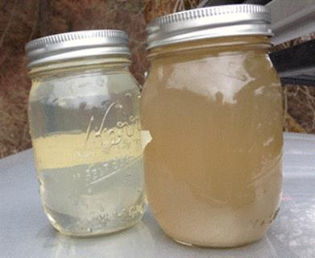
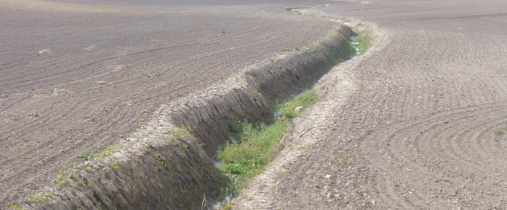
Water Quality Results
Turbidity (Water Clarity): Hangman Creek contained high turbidity in the winter and spring with visibility reduced to as low as 4 cm. This high turbidity is the result of thousands of tons of sediment, due to poor agricultural practices, washing into Hangman Creek each year. This sediment suffocates fish, buries their eggs, and contains other pollution, such as PCB’s.
Spokane
Site 3
Hangman at
Mouth
Site 2
California Creek
Site 1 Hangman at
Waverly
Hangman Creek
Water from the mouth of California Creek (left) and Hangman Creek (right) during a runoff event on 2/10/15.
Map of Hangman Creek sampling sites
Nutrients: Hangman Creek contains very high levels of nitrates . Nitrates in Hangman Creek may originate from fertilizer allowed to run off farmland. Fertilizer in our surface waters contributes to the toxic algal blooms in Lake Spokane. Phosphate pollution is a concern in Hangman Creek as well.
Temperature: Water temperature in Hangman Creek exceeded the 18 C standard from June-August. High water temperatures are caused by lack of shade plants, such as trees and shrubs, along the creek bank. Temperatures in Hangman Creek are lethal to native Redband Trout.
The Problem: Bare shorelines allow pollution into our surface waters.
The Solution: Streamside vegetation traps sediment, nutrients and provides shade.

